Slide 1
Segmentation of Life Satisfaction
By Isaac Ng Sheng

Slide 2
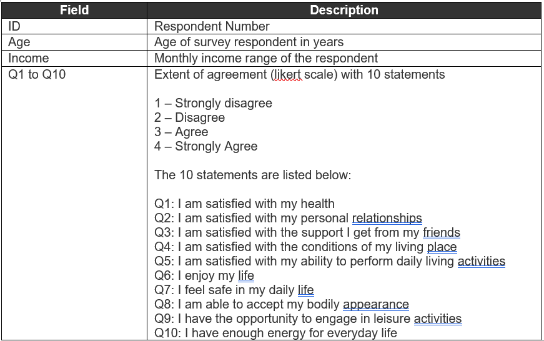
Data
The accompanying dataset contains survey data from 700 respondents on various aspects of their life satisfaction.
Some Survey Questions appear to have possible correlations

Slide 3
Choice of Technology
Principal Component Analysis (PCA) & K-Means Clustering (KMC)
Goal: Segment respondents into different groups with each having similar attitudes towards life satisfaction and each group is distinctly different from each other
All questions were relevant to life satisfaction, with possibly Q6 (I enjoy my life) having the most weightage
PCA in order to locate characteristics which are least correlated to each other, while KMC in order to cluster the datapoints into distinct groups
R Programming Language
Familiarity with PCA & KMC through this language
Ease of data cleaning with various functions able to edit datapoints across rows and columns

Slide 4
Data Cleaning
Two Approaches for missing data:
1. Qualitatively replace each respondent’s missing data, based on the remaining answers
E.g. Missing Q1 (health) result would be replaced by the rounded mean of Q4 (living condition), Q5 (ability to perform daily activities), Q8 (bodily appearance), Q9 (leisure) & Q10 (energy for daily life)
Preserve more data but may lead to possible inaccuracies of data for respondents with incomplete results due to assuming correlation
2. Drop entire respondent’s data
Ensure accuracy of data but reduced quantity of datapoints
Original: 700, Remaining: 668, Data Lost: 32
Total 95.4% of the data is preserved after cleaning

Slide 5
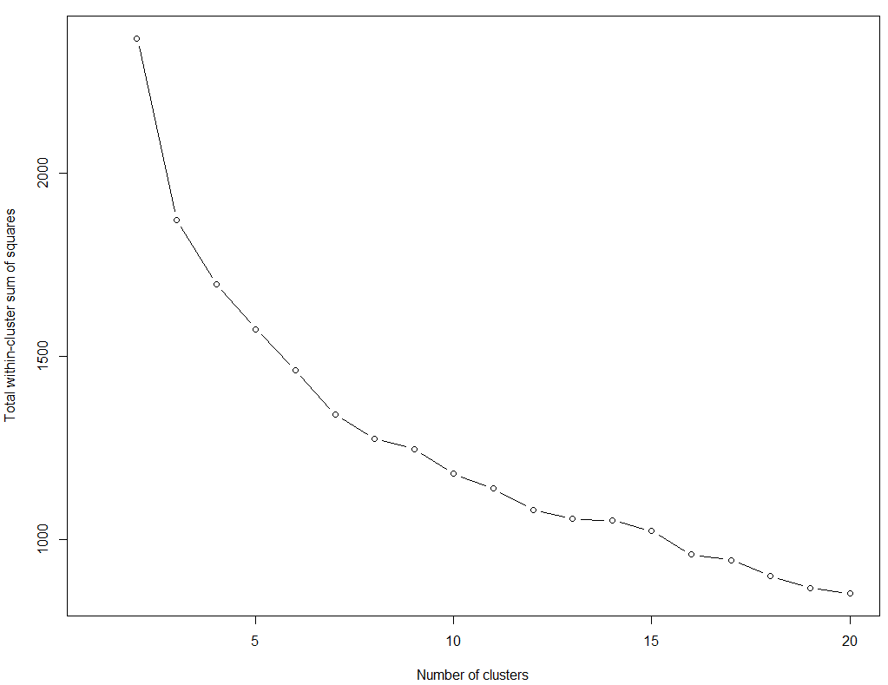
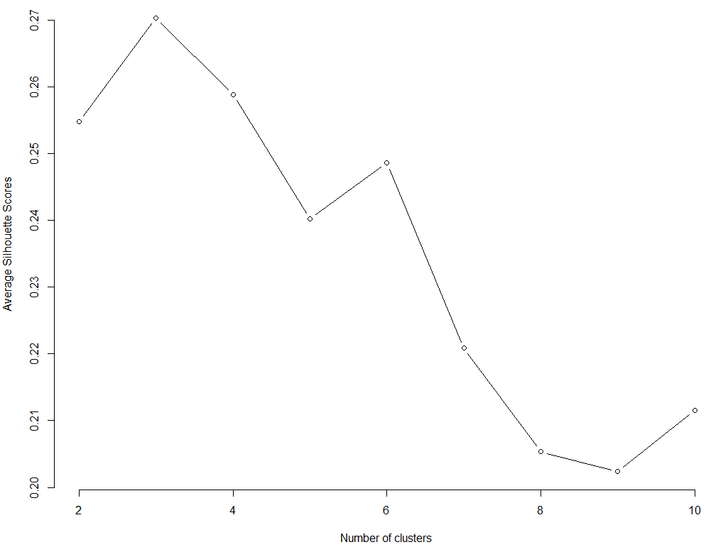
Verifying number of clusters
Elbow Method (Qualitatively decided, covered in university)
Add-on approach: Calculating Silhouette Score (Quantitative, self-learnt)
Final Result: 3 clusters

Slide 6
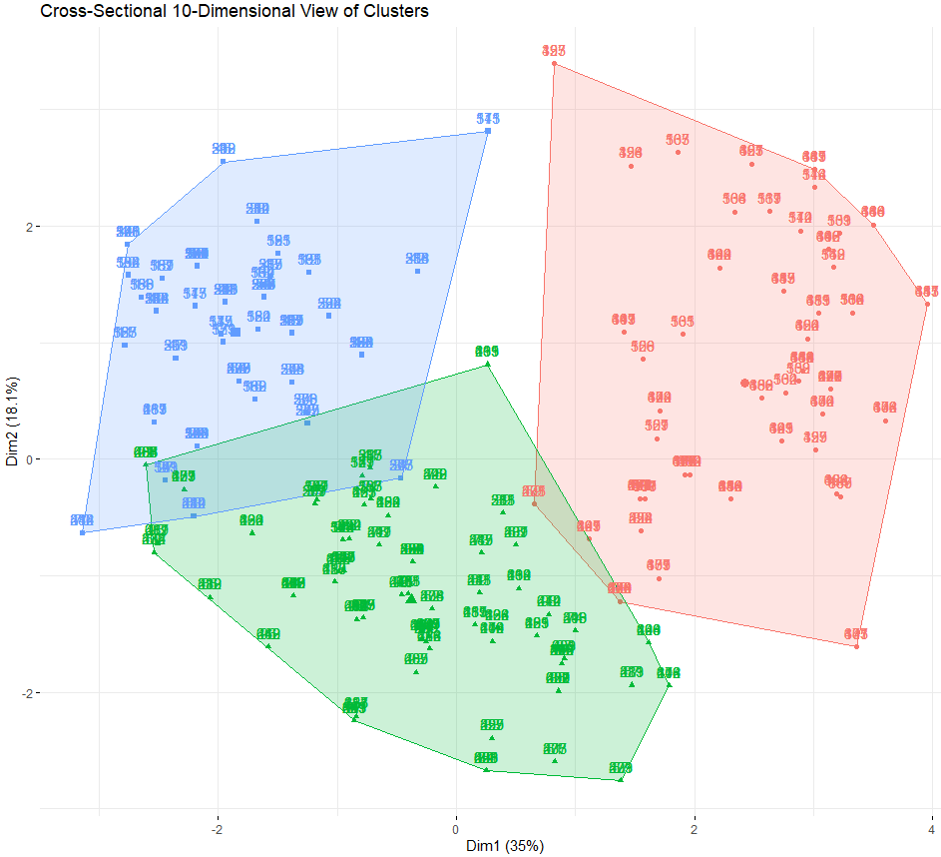
Generating Clusters
Cross-Sectional View involves the plane of the first two Principal Components

Slide 7
Characteristics of Clusters
Cluster 1: Hopeful
High energy for daily life, above average for conditions with living space
Low personal relations, support from friends, enjoyment of life
Cluster 2: Confident/Optimist
High body appearance
Low support from friends, ability to perform daily activities, safety, opportunity for leisure
Cluster 3: Pessimists working on themselves
High energy, income, living conditions, bodily appearance, health and ability to perform daily activities
Low personal relationships and enjoyment of life
Notes:
All out of 4
Cluster 1:
Positive: 2.81 energy for daily life, 2.35 for conditions w living space, 2.13 for opportunity for leisure
Negative: about 1.3-1.4 for personal relations, support from friends, enjoyment of life
Cluster 2:
Positive: 3.19 for body appearance, 2.14 for health, 2.25 for personal relationships
Negative: 1.0 -1.3 for support from friends, ability to perform daily activities, safe, opportunity to engage in leisure
Cluster 3:
Positive: 3.23 for energy, 2.92 for conditions w living space, 2.83 for bodily appearance, 2.84 for health, 2.47for ability to perform daily living activities
Negative: about 1.15 for personal relationships and enjoying life

Slide 8
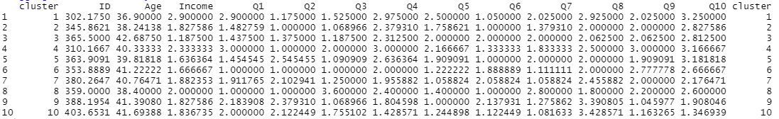
Remarks
Recognized that K-Means Clustering is not optimal for Ordered values (Ordinals), as it is hard to find the distance between ordered categorical values.
Tested with Hierarchical Clustering instead using Ward’s Method (most similar to K-Means Clustering)
Attained 10 Clusters with Hierarchical Clustering, where 3 of them mimics the original 3 from K-Means Clustering
Where:
Cluster 1 of Hierarchical ≈ Cluster 3 of K-Means;
Cluster 3 of Hierarchical ≈ Cluster 1 of K-Means;
Cluster 9 of Hierarchical ≈ Cluster 2 of K-Means
Notes:
Did not want to present this as 10 Clusters is too messy to present

